Slide 1
生信小课堂（Ⅱ期）
LLLAB
2018.06.11

Slide 2
小课堂的初心
团队发展和课题需要
04
实验室内更多课题和数据需要生信手段进行探索和发现
生物信息学发展前景
生命科学领域对（基因组/转录组/表观组等）数据分析的需求越来越大
03
01
提升个人技能
适应发展需要，个人与团队一起成长
02
营造学习和分享生信知识的氛围
希望每个人乐于成为知识的输出着，分享他人

Slide 3
Organization and Structure of Genomes
Genomes
Chromosomes
Genes
mRNA
Noncoding RNAs, e.g. small RNAs
Proteins
From Slides_03 @ http://girke.bioinformatics.ucr.edu/GEN242/mydoc_schedule.html

Slide 4
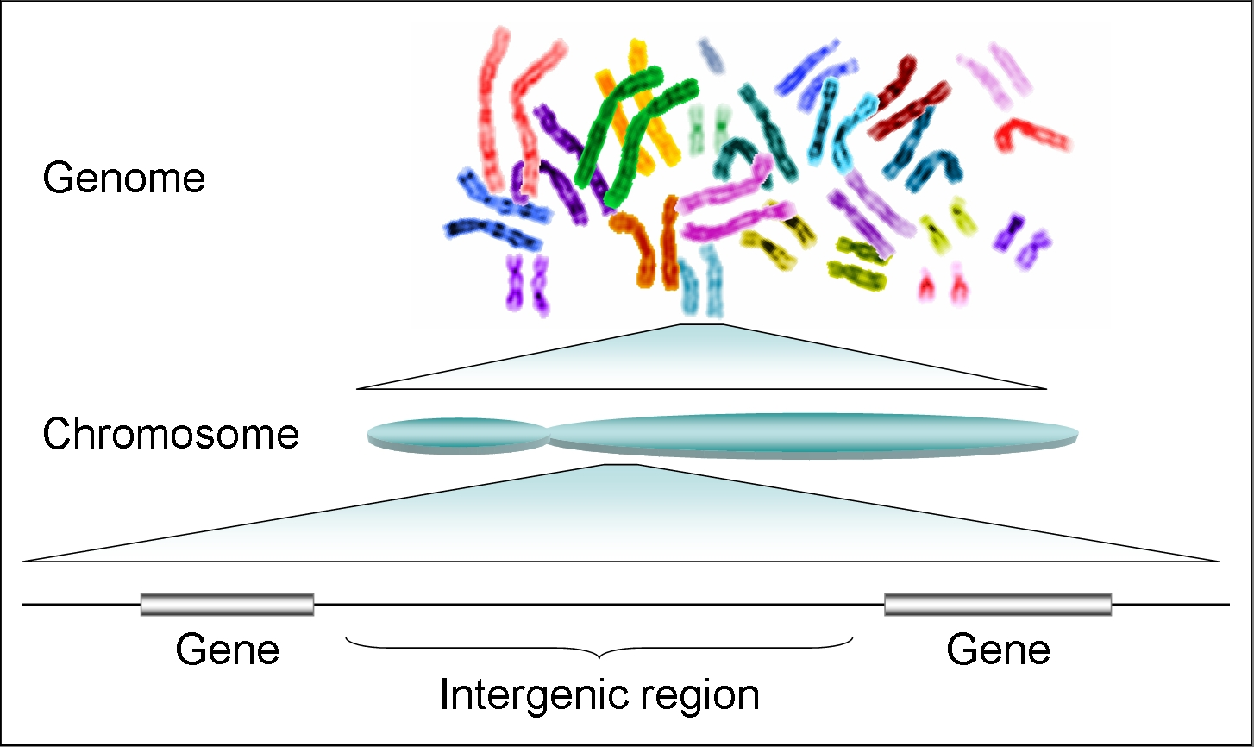
From Genomes to Genes
From Slides_03 @ http://girke.bioinformatics.ucr.edu/GEN242/mydoc_schedule.html

Slide 5
Genome Sizes
Organism | Genome Size (bp) | Genes
Phage Phi-X 174 (virus) | 5.3 ∗ 10³ | 10
Escherichia coli (bacterium) | 4.6 ∗ 10⁶ | ~4,000
Saccharomyces cerevisiae (yeast) | 12.5 ∗ 10⁶ | ~6,000
Arabidopsis thaliana (plant) | 1.3 ∗ 10⁸ | ~28,000
Fritillaria assyrica (plant) | 1.3 ∗ 10¹¹ | NA
Caenorhabditis elegans (nematode) | 1 ∗ 10⁸ | ∼19,500
Homo sapiens | 3 ∗ 10⁹ | ~30,000
Only approximate numbers are given in this table.
The numbers usually vary with the quality of a genome assembly.
The most accurate numbers can be found in genome databases (e.g. NCBI).
From Slides_03 @ http://girke.bioinformatics.ucr.edu/GEN242/mydoc_schedule.html

Slide 6
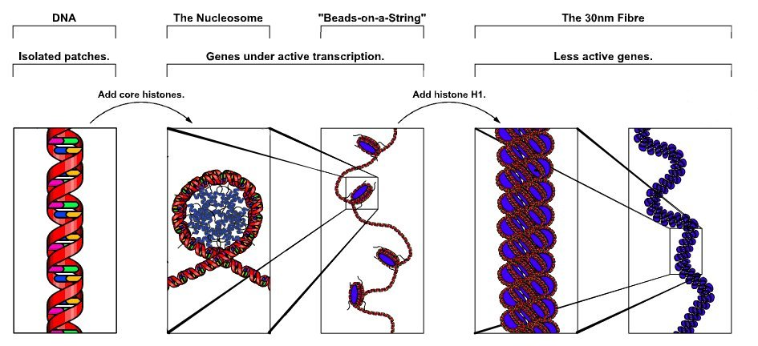
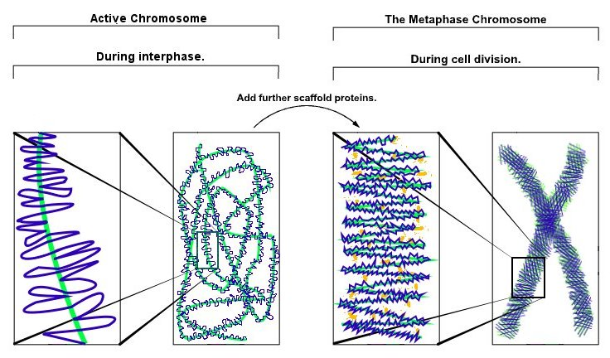
Chromatin
Chromatin: complex of DNA and protein that makes up chromosomes.
Histones are the major protein component.
Functions: DNA packaging in mitosis and meiosis, and to serve as a mechanism to control expression and DNA replication
Molecular Biology of the Cell Online [Alberts et al. 2002]
From Slides_03 @ http://girke.bioinformatics.ucr.edu/GEN242/mydoc_schedule.html

Slide 7
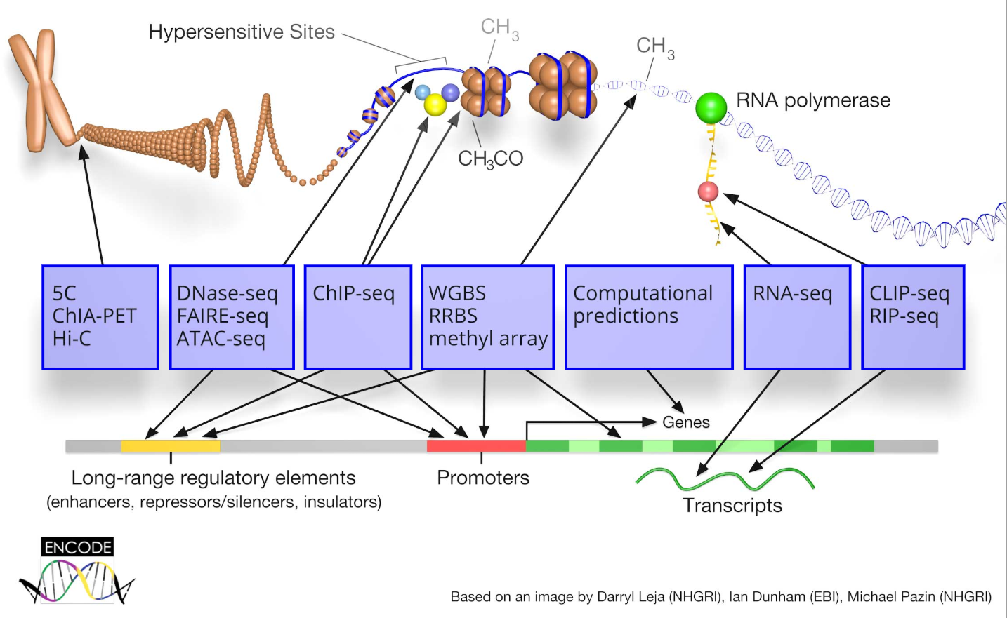
组学数据往往是全基因组规模单碱基精度的
能够从细胞的内在分子特征入手，帮助识别细胞类型，发现调控网络，揭示新的生物学知识。
https://www.encodeproject.org/
Learn more about Bioinformatics,
See Slides_01 @ http://girke.bioinformatics.ucr.edu/GEN242/mydoc_schedule.html

Slide 8
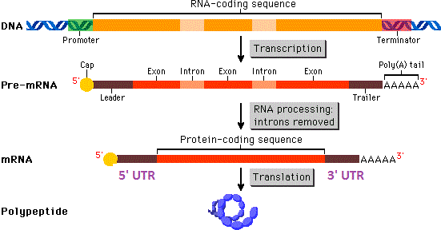
基因组水平
组蛋白修饰
DNA甲基化
时空构象
转录后调控
可变剪切体
RNA 修饰
miRNA
lncRNA
转录调控
Cis-regulatory
Promoter
Enhancer
Silencer
Trans-regulatory
Transcription Factor
lncRNA
蛋白水平
蛋白修饰
（乙酰化、磷酸化、泛素化…）
分子间通信
（信号通路，蛋白互作等）

Slide 9
课程提纲
Basic Tools
Data Preprocessing
Analysis of Profiling Data
Biological Exploration
Linux & R
From fastq data to gene expression matrix
Seurat
HVG, DR, Clustering, DEG,
DEG and Marker gene
clusterProfiler
GSEA
`
1
2
3
4
5
6
7
8
Sequencing Data
R programming
Data Visualization
Course Project
Smartseq2 & STRT-seq
Basic grammar
ggplot2
Adobe Illustrator
Reproduce results of a research
熟悉单细胞转录组数据分析

Slide 10
课时一
基础软件
Linux & R

Slide 11
Content
LinuxOnWindows10
Installation
command line
Conda
installation
usage
R&Rstudio
installation
intro

Slide 12
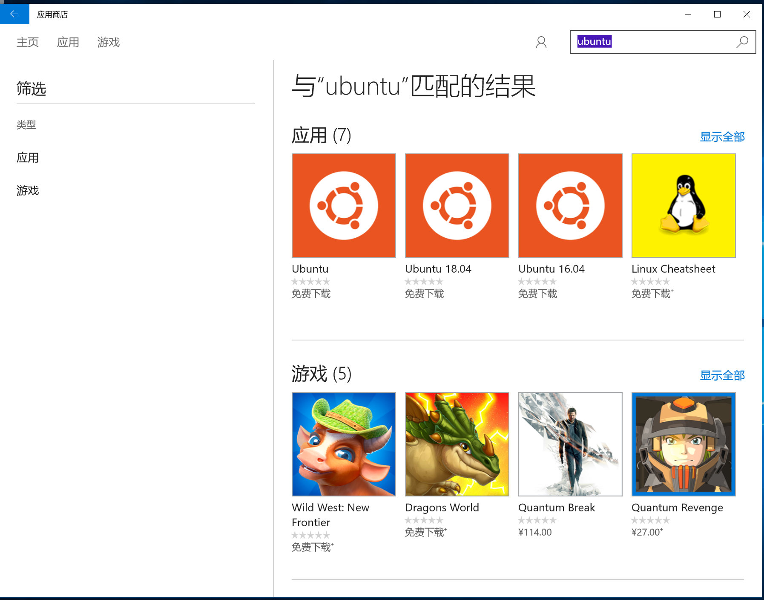
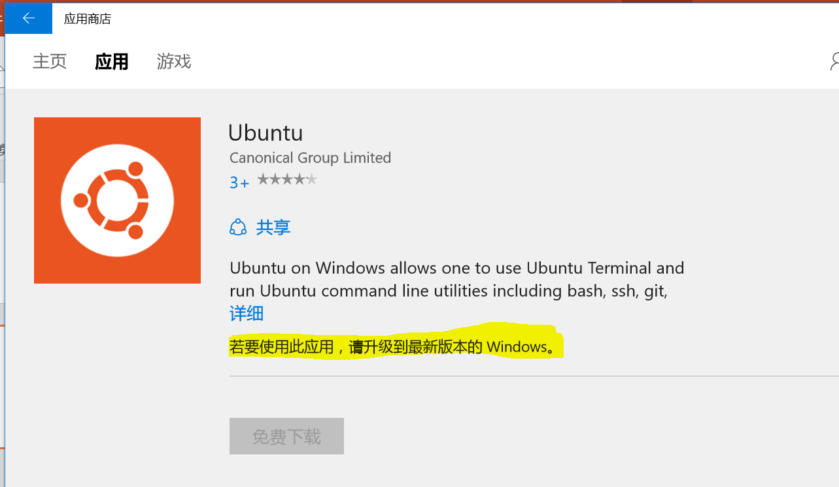
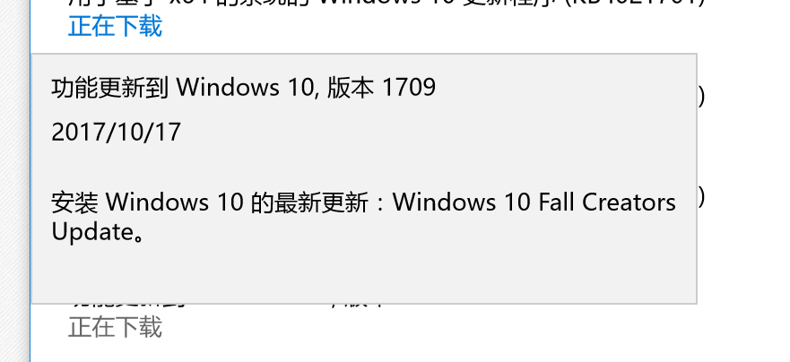

Slide 13

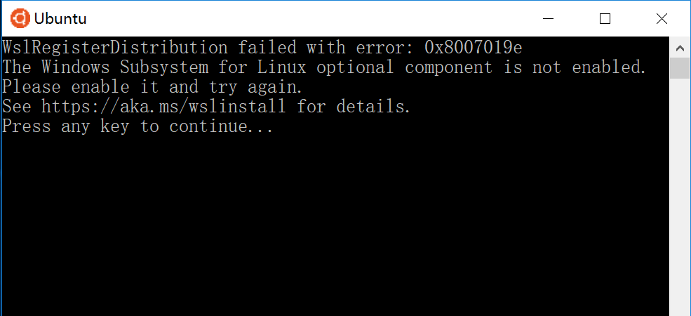

Slide 14
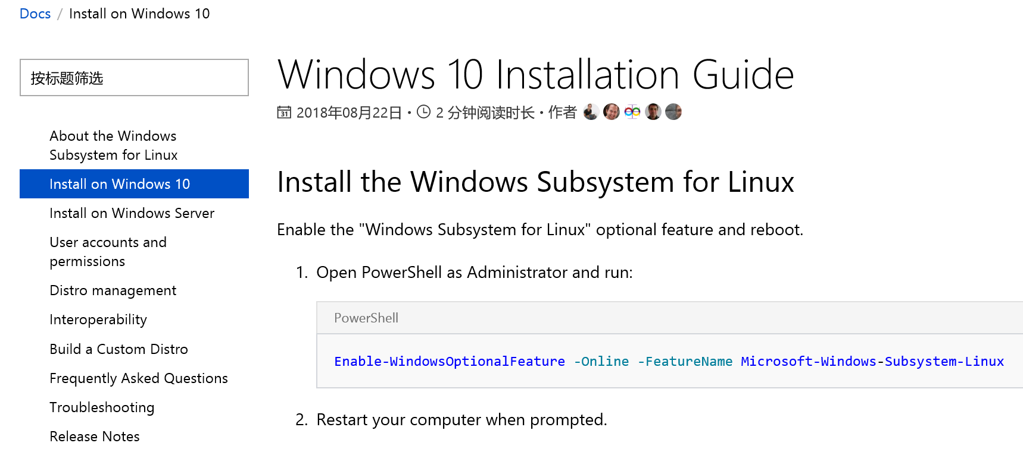
Enable-WindowsOptionalFeature -Online -FeatureName Microsoft-Windows-Subsystem-Linux

Slide 15
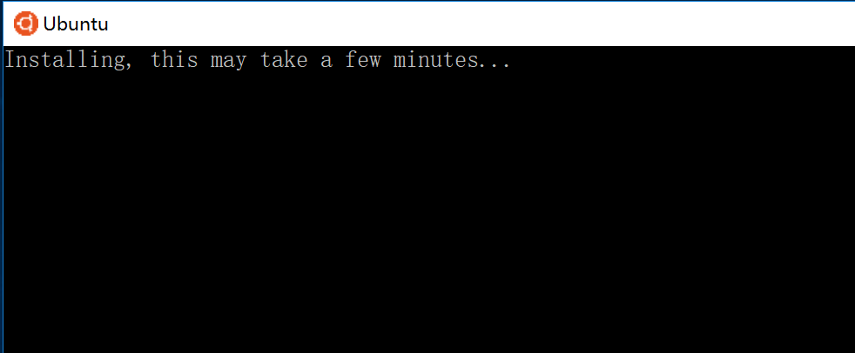
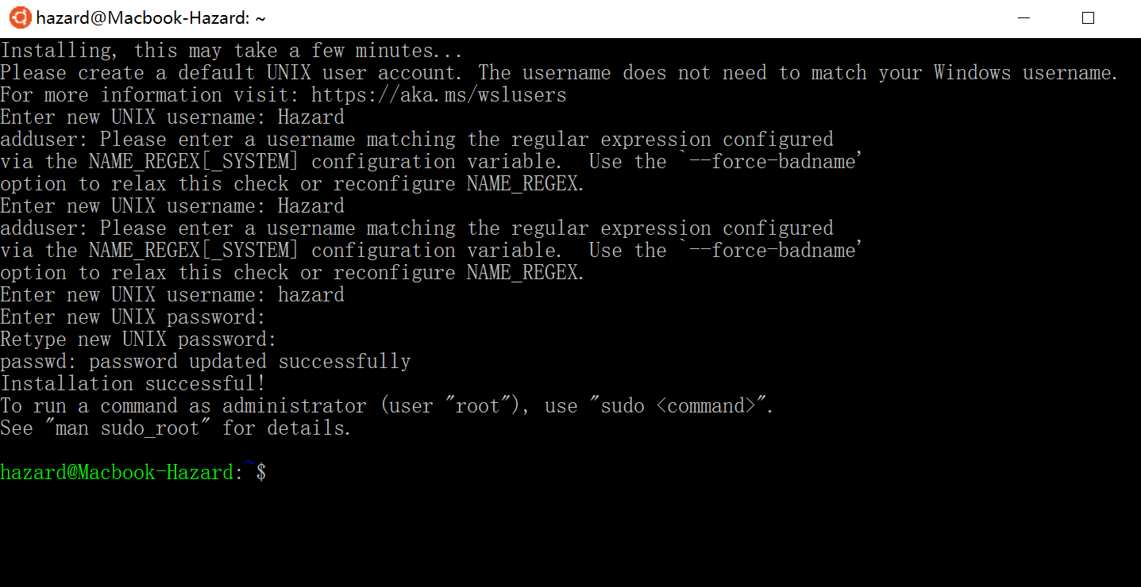
Commad prompt
Commad [options] arguments
如 ls –al .

Slide 16
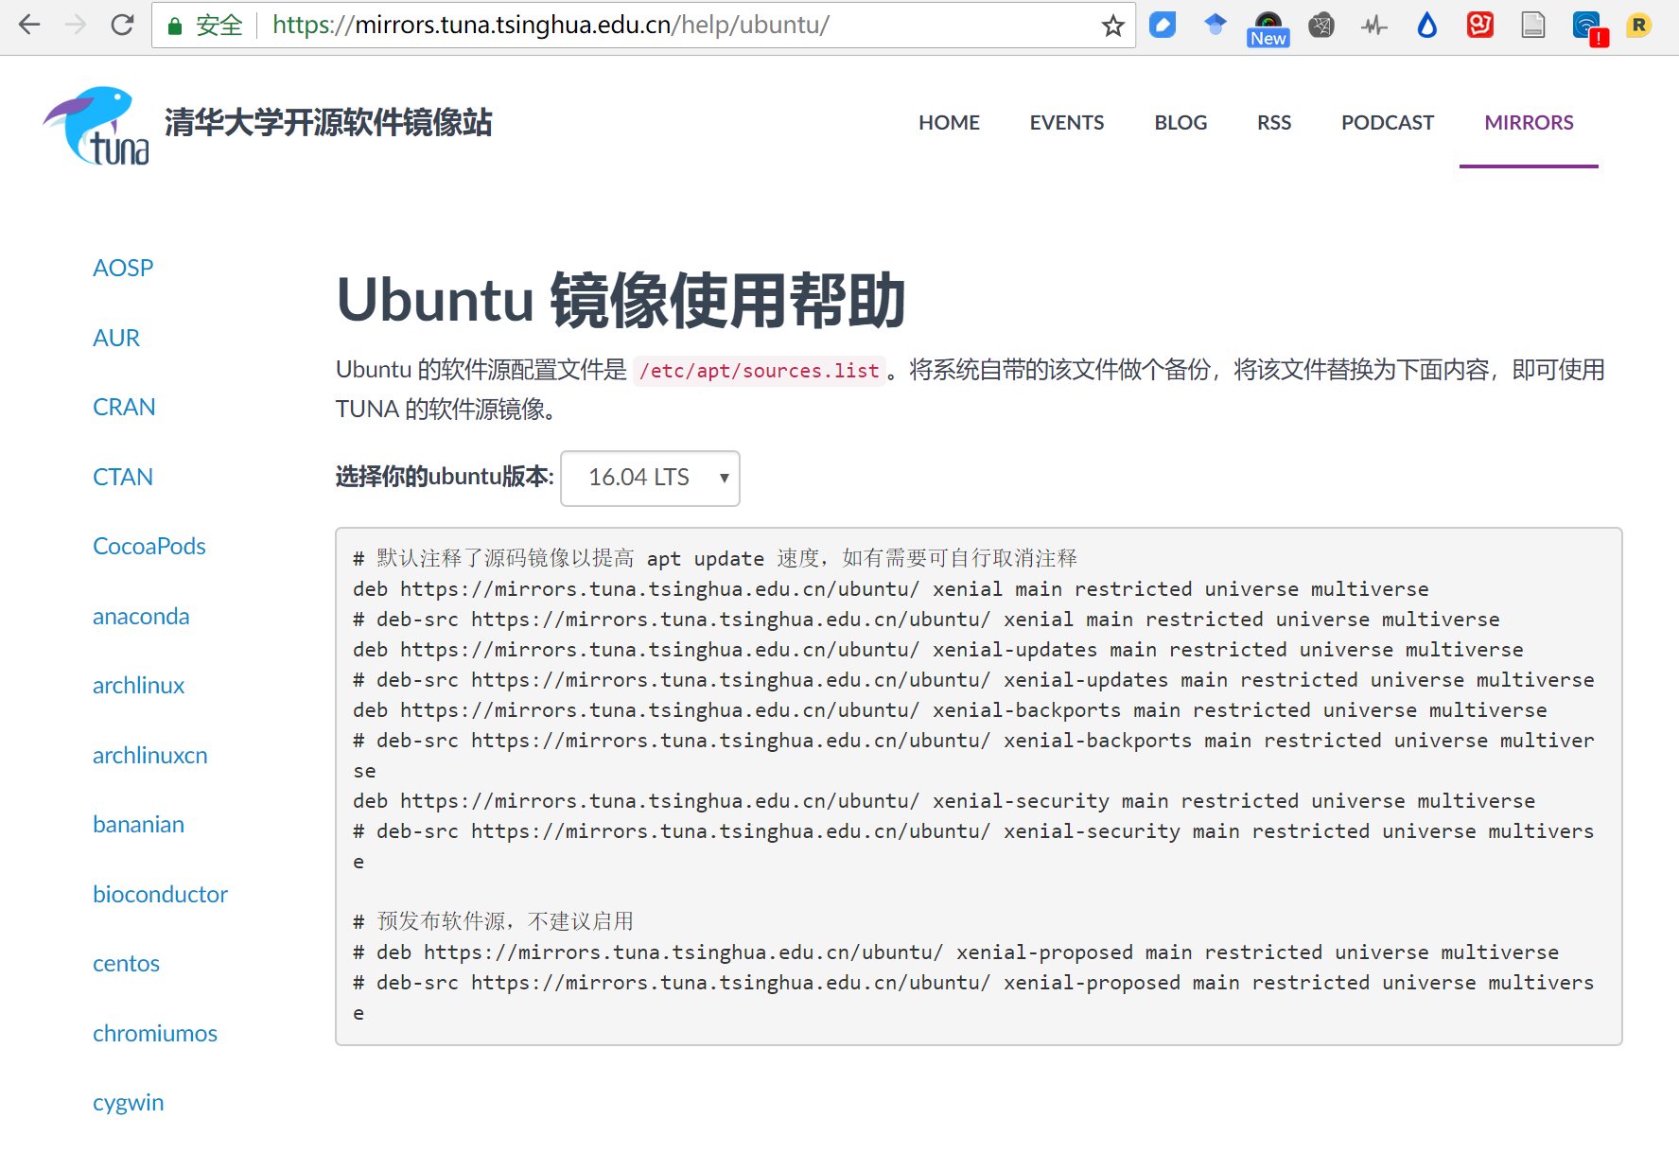
Notes:
# 默认注释了源码镜像以提高 apt update 速度，如有需要可自行取消注释
deb https://mirrors.tuna.tsinghua.edu.cn/ubuntu/ xenial main restricted universe multiverse
# deb-src https://mirrors.tuna.tsinghua.edu.cn/ubuntu/ xenial main restricted universe multiverse
deb https://mirrors.tuna.tsinghua.edu.cn/ubuntu/ xenial-updates main restricted universe multiverse
# deb-src https://mirrors.tuna.tsinghua.edu.cn/ubuntu/ xenial-updates main restricted universe multiverse
deb https://mirrors.tuna.tsinghua.edu.cn/ubuntu/ xenial-backports main restricted universe multiverse
# deb-src https://mirrors.tuna.tsinghua.edu.cn/ubuntu/ xenial-backports main restricted universe multiverse
deb https://mirrors.tuna.tsinghua.edu.cn/ubuntu/ xenial-security main restricted universe multiverse
# deb-src https://mirrors.tuna.tsinghua.edu.cn/ubuntu/ xenial-security main restricted universe multiverse
# 预发布软件源，不建议启用
# deb https://mirrors.tuna.tsinghua.edu.cn/ubuntu/ xenial-proposed main restricted universe multiverse
# deb-src https://mirrors.tuna.tsinghua.edu.cn/ubuntu/ xenial-proposed main restricted universe multiverse

Slide 17
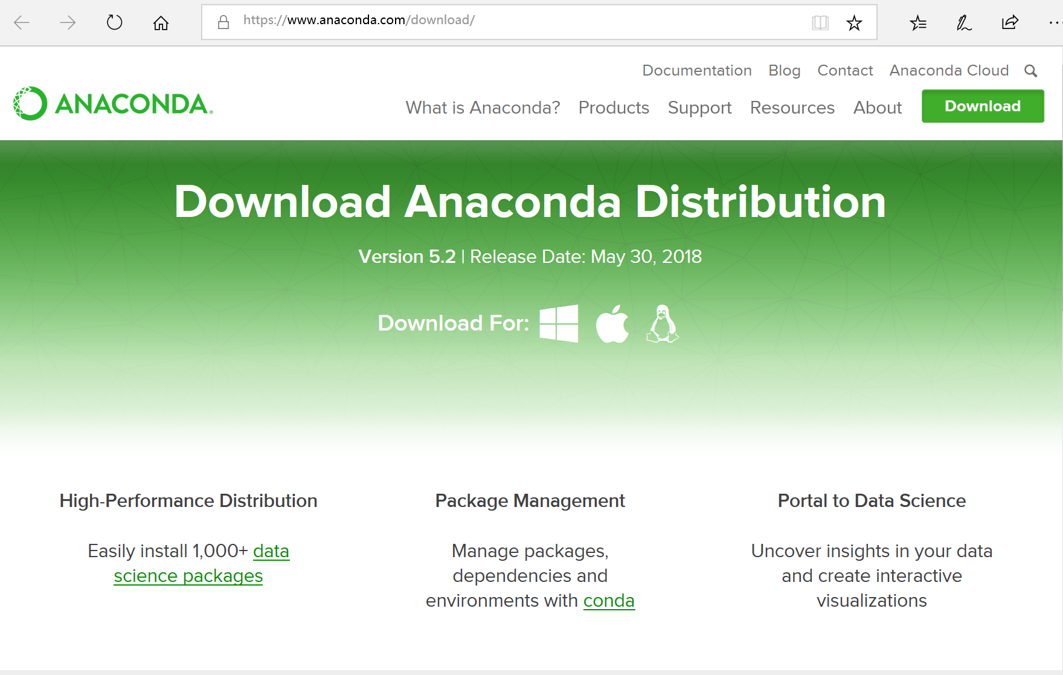

Slide 18
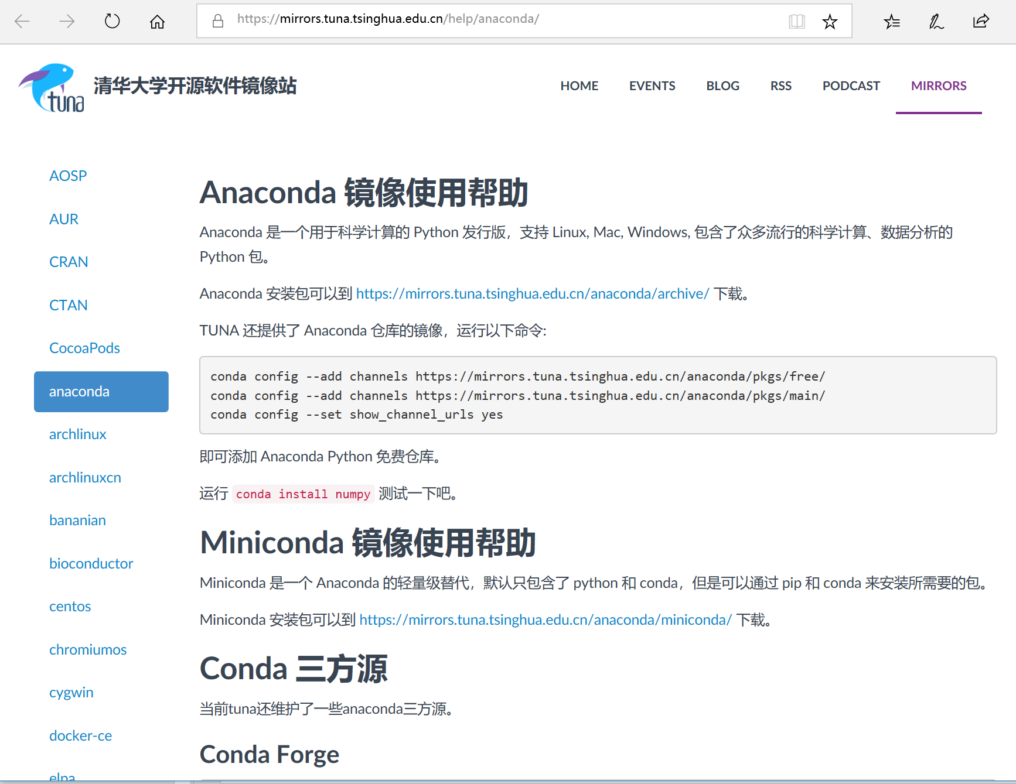
bioconda
conda config --add channels https://mirrors.tuna.tsinghua.edu.cn/anaconda/cloud/bioconda/
Notes:
conda config --add channels https://mirrors.tuna.tsinghua.edu.cn/anaconda/pkgs/free/
conda config --add channels https://mirrors.tuna.tsinghua.edu.cn/anaconda/pkgs/main/
conda config --set show_channel_urls yes
conda config --add channels https://mirrors.tuna.tsinghua.edu.cn/anaconda/cloud/bioconda/

Slide 19


https://mirrors.tuna.tsinghua.edu.cn/CRAN/
https://www.rstudio.com/products/rstudio/download/#download

Slide 20
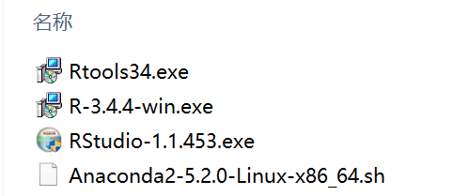
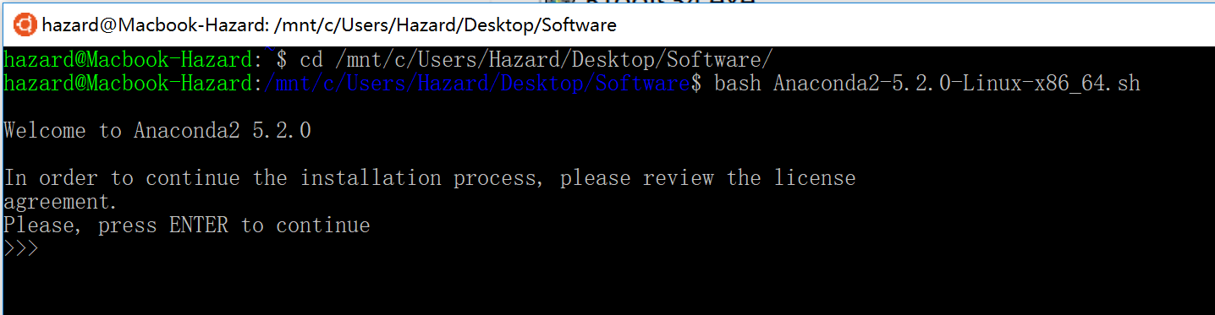
基础软件
使用服务器的同学
- 192.168.1.100:47283 （Rstudio Server）
FileZilla
Putty

Slide 21
Important Linux Commands
Finding help
man <program_name>
List content of current directory
ls
Print current working directory
pwd
Search in files and directories
grep
Word count
wc
Create directory
mkdir
Delete files and directories
rm
Move and rename files
mv
Copy files from internet to pwd
wget
Viewing files
less
STD IN/OUT/ERR, Redirect & Wildcards
Wildcard * to specify many files
file.*
Redirect ls output to file
ls > file
Specify file as input to command
command < myfile
Append output of command to file
command >> myfile
Pipe STDOUT of one command to another command
command1 | command2
Turn off progress info
command > /dev/null
Pipe output of grep to wc
grep pattern file | wc
Print STDERR to file
grep pattern nonexistingfile 2 > mystderr
Permissions and ownership
List directories and files
ls -al
The previous command shows something like this for each file/dir: drwxrwxrwx. The meaning of this syntax is as follows:
d: directory
rwx: read, write and execute permissions, respectively
first triplet: user permissions (u)
second triplet: group permissions (g)
third triplet: world permissions (o)
Example for assigning write and execute permissions to user, group and world
chmod ugo+rx my_file
+ causes the permissions selected to be added
- causes them to be removed
= causes them to be the only permissions that the file has.
Syntax for changing user & group ownership
chown <user>:<group> <file or dir>
Symbolic Links
Symbolic links are short nicknames to files and directories that save typing of their full paths.
ln -s original_filename new_nickname
http://girke.bioinformatics.ucr.edu/GEN242/mydoc_tutorial_02.html

Slide 22
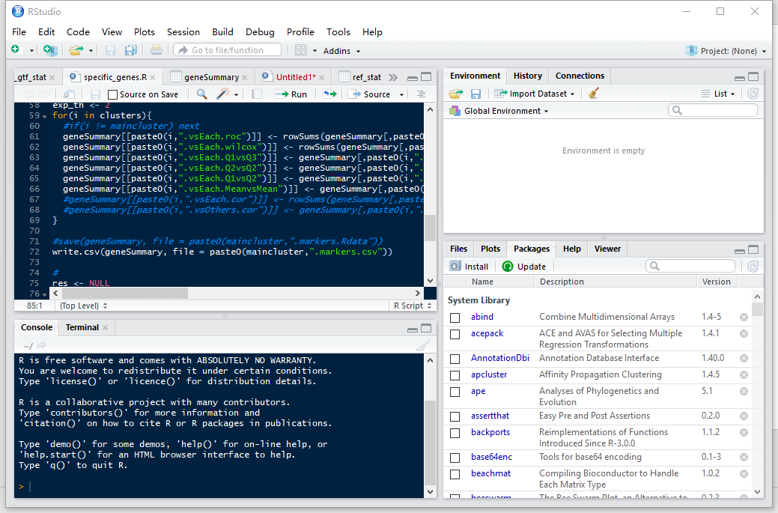

Slide 23
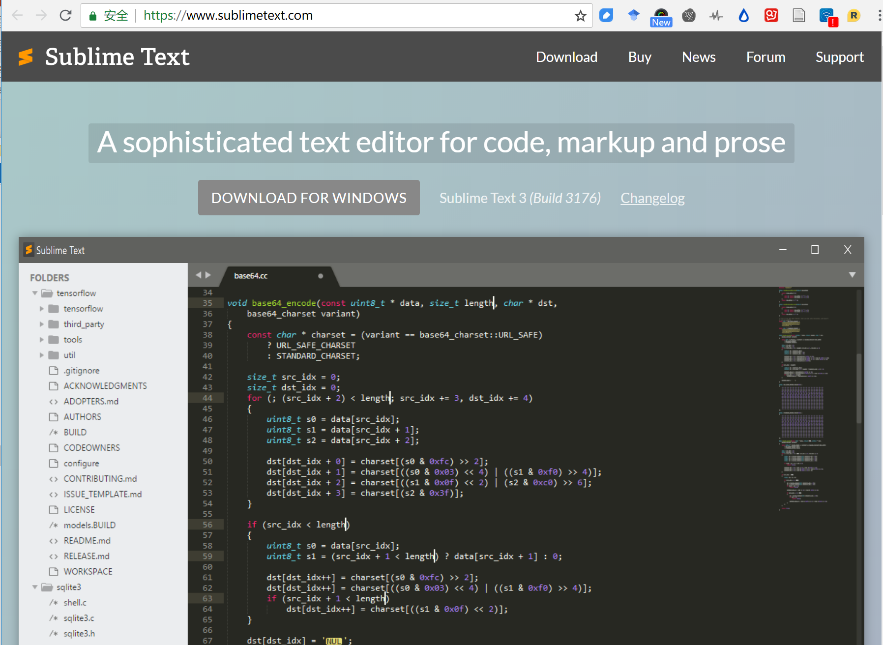

Slide 24
一个问题困住了我，我该怎么办？
我们应该尽量按照推荐的方式来安装和运行程序，编写代码，使用软件包等。
尽管如此，遇到问题仍是常有的事。
我们要做的第一件事情是，阅读帮助文档，尝试自行解决。
但并不建议死磕一个难题，必要的时候，在群里提问会更快的得到解答。
特别是学习初期，很多坑前人已经踩过。
01.自学成才
阅读帮助文档，查看社区讨论（Github Issues等）
借助搜索引擎Google，寻找相似问题答案。如果你还在用百度，请改变你的习惯（中文搜索除外）。
阅读文献Methods学习更多新算法
02.向他人求助
准备好自己的问题，在小课堂群里提问。
学会如何优雅的提问（#阅读公众号文章）
值得探讨的问题，往往能激发讨论，解决每个难题都是一种进步。

Slide 25
Homework
1. 熟悉Linux操作系统
参考PPT内容安装和启用LinuxOnWindows
修改软件源
熟悉Linux命令行操作
2. 使用Anaconda安装生信工具
在Linux下安装Anaconda2
修改软件源
使用conda 命令安装下列软件包（hisat2, samtools, htseq）
3. 熟悉R和Rstudio
在Windows上安装R，Rtools，Rstudio
熟悉Rstudio界面
#4. 熟悉Github
https://guides.github.com/activities/hello-world/
http://girke.bioinformatics.ucr.edu/GEN242/mydoc_tutorial_01.html
学会Git操作
使用Github管理代码

